Slide 1

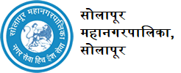
“SAMVED” HACKATHON 2026
TITLE PAGE
Problem Statement ID – 001
Problem Statement Title- Smart Road Damage Reporting & Rapid Response System for Solapur Municipal Corporation
Theme- Disaster management
Team ID- MITVPU_SAMVED_TEAM 38
Team Name - TrackX

Slide 2
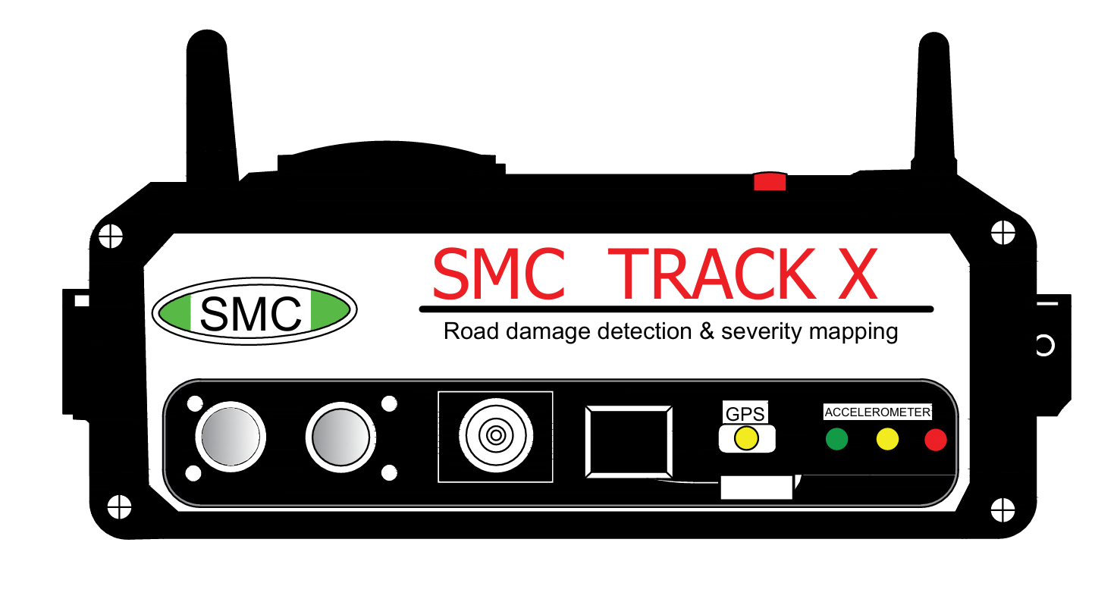
Automatic Road Condition Monitoring System
TrackX
Description of Idea
Proposed an IoT-based road condition monitoring system mounted on municipal vehicles for real-time road inspection.
Ultrasonic sensors and accelerometer detect potholes, humps, vibrations, and road irregularities.
Camera and GPS capture road images and exact location of damaged areas.
Raspberry Pi processes data and performs severity mapping (Low / Medium / High).
Data is sent to the cloud and displayed on a municipal dashboard for monitoring.
Issues are assigned to relevant departments, with automatic escalation to the Commissioner if delayed.

Slide 3
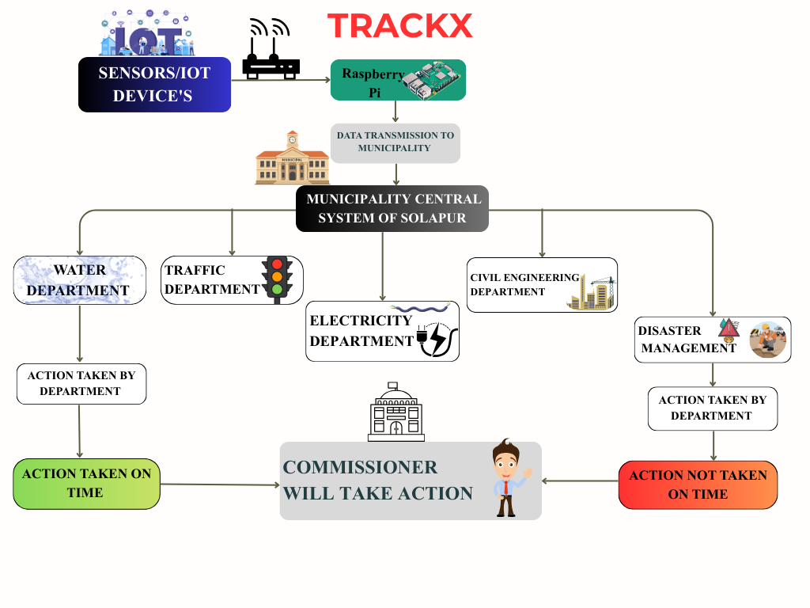
Technical Approach
Trackx
Technologies to be used:
Internet of Things, Machine Learning, Cloud Analytics
Hardware Tools:
Ultrasonic Sensor , Accelerometer(MPU6050),
Camera Module, GSM, GPS Module & Raspberry Pi Controller.
Software Tools:
Wireless Communication, Municipality Dashboard, Python IDE
Implementation Flow
System deployed on municipal vehicle moves around the area.
Sensors continuously collect data
Road surface check:
Normal → Continue monitoring
Not Normal → Proceed to analysis
Measure depth & vibration, Capture road image.
Fetch GPS location
Calculate severity(Low / Medium / High),Store &send data to cloud
Display on municipality dashboard

Slide 4

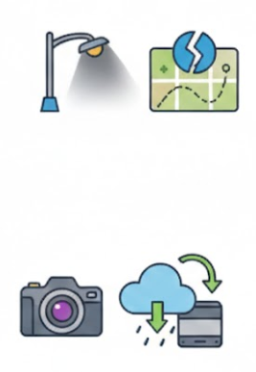
Feasibility and Viability
TrackX
Feasibility
Can be installed on existing municipal vehicles
Low-cost and scalable solution
Easy to deploy across urban areas
Challenges
Sensor accuracy in extreme weather
Low visibility during night
Network connectivity issues
Mitigation Strategies
Weatherproof sensors
Night-vision cameras
Offline data storage and Initiate Retransmission data

Slide 5
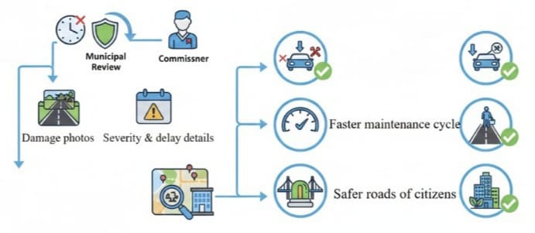
Impact and Benefits
TrackX
Escalation Mechanism
If officers do not respond within stipulated time:
Issue escalated to Municipal Review
Forwarded to Commissioner
Includes:
Location
Damage photos
Severity & delay details
Impact
Real time road condition monitoring
Faster response by municipal authorities
Improved urban road infrastructure
Benefits
Reduced road accidents
Less vehicles damage
Faster maintenance cycle
Safer roads for citizens
Sustainable development of cities

Slide 6
Research and References
TrackX
https://www.bohrium.com/en/paper-details/real-time-dynamic-scale-aware-fusion-detection-network-take-road-damage-detection-as-an-example/1038700816694771718-108597
https://www.bohrium.com/en/paper-details/improved-yolov5-based-real-time-road-pavement-damage-detection-in-road-infrastructure-management/911809225498297245-20453
https://www.researchgate.net/publication/354219786_An_Intelligent_Real_Time_Pothole_Detection_and_Warning_System_for_Automobile_Applications_Based_on_IoT_Technology
https://www.academia.edu/67715371/Real_Time_Pothole_Detection_and_Road_Monitoring_System
file:///C:/Users/Lenovo/Downloads/pcadmmin,+1555948458_NITET-2019.pdf

